Slide 1
ITLG311 - Business Communication
Faculty of ICT, Mahidol University
Semester 1, 2026-27
Session 02: Getting Started
WRITTEN BUSINESS COMMUNICATION

Slide 2
Last Week:
Getting Started:
Useful resources
The purpose and goals of the course
Lesson structures, Activities & Evaluations
Fundamental aspects of effective communication
The audience and adapting communicative needs
Main Principles of Business Communication

Slide 3
This Week:
Objectives:
Differentiate between internal and external audiences
Adapt tone and language for different audiences
Plan business messages before writing

Slide 4
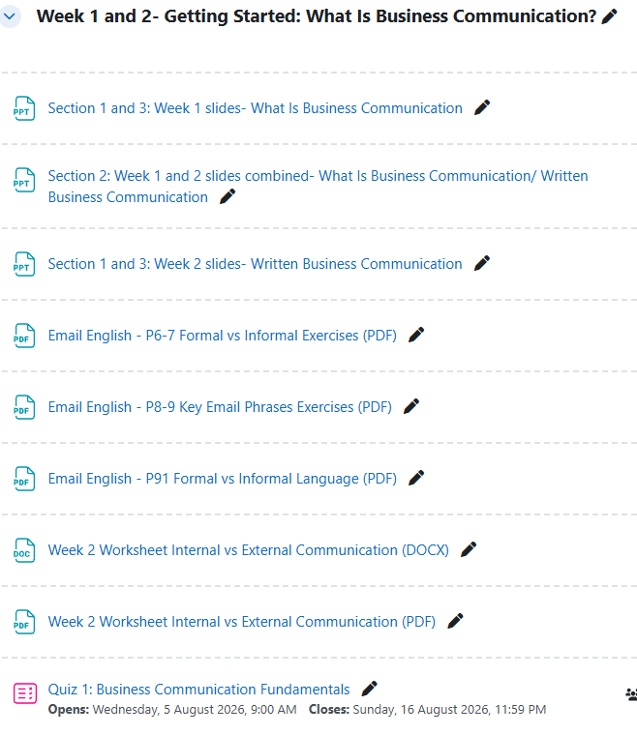
Resources:

Slide 5
The Audience
Knowing and understanding your audience will help you communicate effectively
Consider:
Who is the audience?
How large is the audience?
What are the backgrounds, genders, ages, jobs, education level and interests?
What do you think the audience already knows?
What do you think the audience needs to know or wants to know?
What communication channel/method will best reach the audience?
Self Check:
How would you communicate one-on-one compared to with a large audience.
How would you communicate with someone who is older than you?
Would you communicate differently if you were communicating with your manager instead of a colleague?
Do the same rules/principles apply when communicating electronically?
Note: Also consider the possibility that someone other than the intended audience might also see your message: Be careful!

Slide 6
Internal Audiences
The Internal Audience can be defined as ‘people within your organization’:
Your co-workers
Your boss/supervisor, and subordinates
This means:
You know the people you work with, so it is easy to evaluate their communicative needs as well as the most appropriate method of communicating with them
You are likely to use a range of methods of communication:
  Face-to-face conversations
  SMS or Chat Messages
  Post-it notes
  Telephone Calls
  Memos
  Emails
  Proposals
  Reports
The complexity of the situation and the method of communication usually relates to the level of formality
For example: you would not be likely to send a chat message or a post-it note to you boss when reporting about a serious business situation
complexity

Slide 7
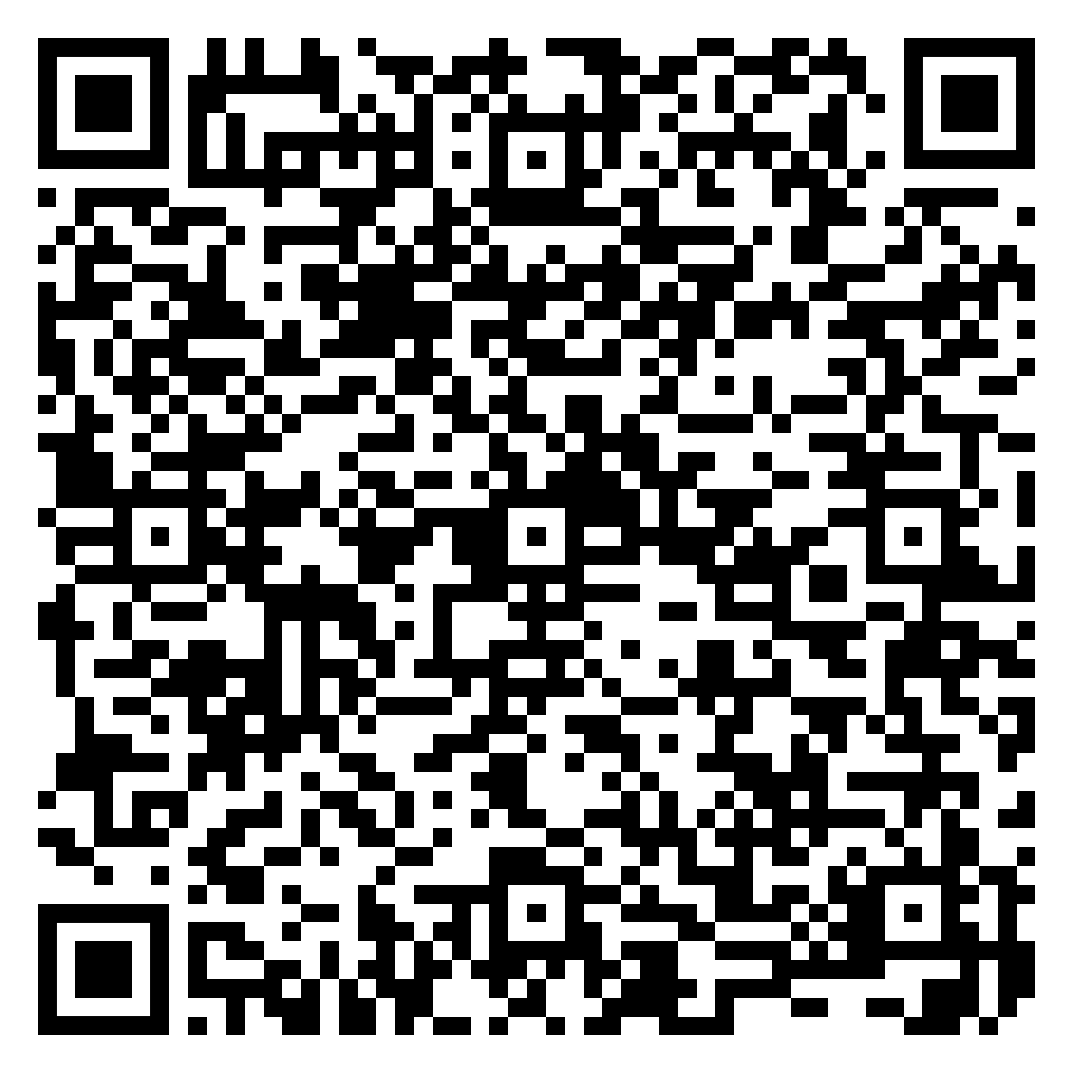
External Audiences:
The External Audience can be defined ‘people outside your organization’:
Suppliers, Distributors, Clients, Customers, Other businesses, etc.
How you interact with them will be determined by the business situation.
What situations would you communicate:
Verbally:
In Writing:
Remember: The underlying purpose of communication with an external audience is to establish and maintain a positive working relationship
Week 2 Worksheet Internal vs External Communication PART A
Notes:
Verbally – quick updates or simple requests, and easy to resolve situations.
Clarification, confirmation, situations that involve time-sensitive information
In writing – most situations that require written responses, or it is important to create a ’paper-trail’ as a record:
Formal requests/provision of specific detailed information

Slide 8
Audience: Target Language: Tone/Formality
Different audiences expect different levels of formality
Define:
Formal:
Neutral/Semi-formal:
Informal:
Notes:
FORMAL:
Definition Professional and carefully structured language used when communicating with people you do not know well, senior staff, clients, or external organizations. Avoid slang, contractions, and overly casual expressions.
Examples:
Greetings: "Dear Sir/Madam,"
Requests: "Could you please provide the necessary documentation?"
Closings: "Yours sincerely,"
Vocabulary: Utilize (instead of use), commence (instead of start), inquire (instead of ask)
Tone: Polite, respectful, and distant
NEUTRAL/SEMI-FORMAL:
Definition: Professional but more natural and friendly language used when communicating with colleagues, regular clients, or people you already have a working relationship with. Some less formal expressions and contractions may be acceptable.
Examples:
Greetings: "Hello [Name],"
Requests: "Could you send me the report when you get a chance?"
Closings: "Best regards,"
Vocabulary: Use (instead of utilize), start (instead of commence), ask (instead of inquire)
Tone: Polite, friendly, and straightforward
INFORMAL:
Definition: Casual and relaxed language used when communicating with people you know well and have a close or familiar relationship with. Contractions, simple expressions, and conversational language are common.
Examples:
Greetings: "Hey [Name],"
Requests: "Can you send me the report?"
Closings: "Cheers,"
Vocabulary: Use (instead of utilize), start (instead of commence), ask (instead of inquire), chat (instead of discuss)
Tone: Relaxed, friendly, and personal
Connect to
Intelligent Business Style Guide P7, P9-11
Email English: P6-7, P8-9, P91

Slide 9
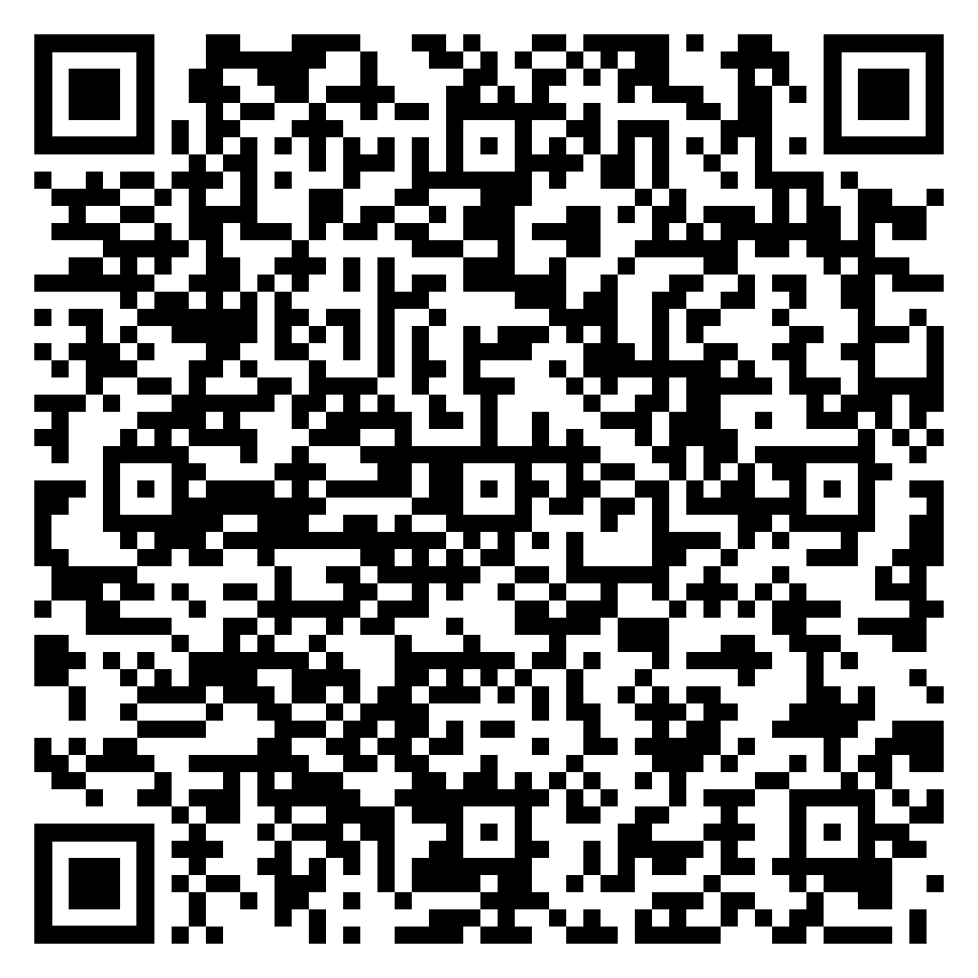
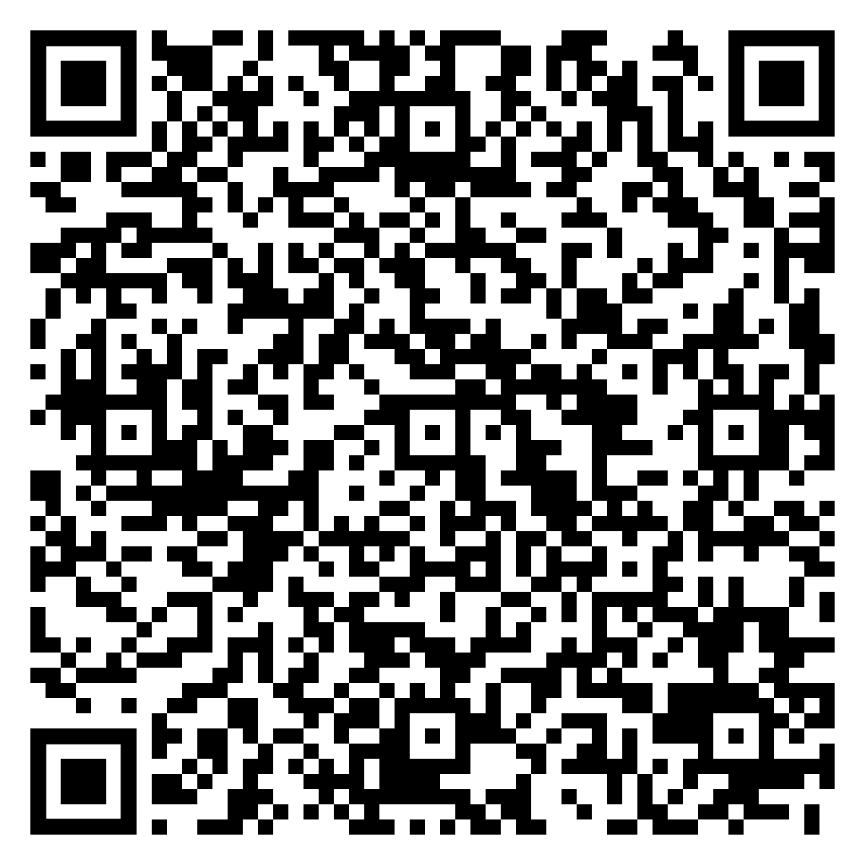
Audience: Target Language: Tone/Formality Exercises
Week 2 Worksheet Internal vs External Communication PART B
Notes:
FORMAL:
Definition Professional and carefully structured language used when communicating with people you do not know well, senior staff, clients, or external organizations. Avoid slang, contractions, and overly casual expressions.
Examples:
Greetings: "Dear Sir/Madam,"
Requests: "Could you please provide the necessary documentation?"
Closings: "Yours sincerely,"
Vocabulary: Utilize (instead of use), commence (instead of start), inquire (instead of ask)
Tone: Polite, respectful, and distant
NEUTRAL/SEMI-FORMAL:
Definition: Professional but more natural and friendly language used when communicating with colleagues, regular clients, or people you already have a working relationship with. Some less formal expressions and contractions may be acceptable.
Examples:
Greetings: "Hello [Name],"
Requests: "Could you send me the report when you get a chance?"
Closings: "Best regards,"
Vocabulary: Use (instead of utilize), start (instead of commence), ask (instead of inquire)
Tone: Polite, friendly, and straightforward
INFORMAL:
Definition: Casual and relaxed language used when communicating with people you know well and have a close or familiar relationship with. Contractions, simple expressions, and conversational language are common.
Examples:
Greetings: "Hey [Name],"
Requests: "Can you send me the report?"
Closings: "Cheers,"
Vocabulary: Use (instead of utilize), start (instead of commence), ask (instead of inquire), chat (instead of discuss)
Tone: Relaxed, friendly, and personal
Connect to
Intelligent Business Style Guide P7, P9-11
Email English: P6-7, P8-9, P91

Slide 10
Language Tone/Formality Activity
Rewrite each message to make it more professional and appropriate
Fix this!
The app is broken.
Send me the report!
You made a mistake.
Your password is wrong.

Slide 11
Language Tone/ Formality- Possible Answers
Rewrite each message to make it more professional and appropriate
Could you please investigate and resolve this issue as soon as possible?
We are currently experiencing a technical issue with the mobile application.
Could you please send me the project report by the end of today?
I noticed a possible error in the document.
The password you entered is incorrect.

Slide 12
Audience Analysis
Week 2 Worksheet Internal vs External Communication PART C
Effective business communicators plan before they write.
Ask yourself:
Who will read this message?
What do they already know?
What do they need to know?
What action do I want them to take?
What information should I leave out?
Different audiences require different messages.
Different audiences require different:
Information
Vocabulary
Tone
Level of detail
Required Action

Slide 13
BREAK TIME

Slide 14
A Structured Business Message
Always plan your message before you produce it
Define your targeted audience, purpose, and aspects of communicative principles

Slide 15
Put it together: Apply today’s concepts
Audience → Purpose → Information → Tone → Organization → Write
Week 2 Worksheet Internal vs External Communication PART D, E, F, and G
Using Parts D , E, F, G of your worksheet:
Evaluate two business messages.
Plan an appropriate message for a company manager.
Plan an appropriate message for software developers.
Write out one of your planned messages

Slide 16
NOTICE: Quiz 1
MyCourses Quiz 1: Business Communication Fundamentals
General Business Communication Theory
Fundamental Business Vocabulary/Phrasing
Quiz Conditions:
Quiz 1 will close at 23:59, Sunday 16 August 2026
Only one attempt allowed
One hour (60 minutes) time limit
Be sure to review lesson 1 and 2 notes and resources before your attempt
GOOD LUCK!

Slide 17
Congratulations on surviving another class
THANK YOU for your participation today
Have a great week everyone!
See you next week
Until then, Take Care & Stay Safe
Finally….

